Slide 1
Elm Fundamentals
Rich Web Application Technologies

Slide 2
Web Technology Stack
As noted before, the technology stack we use to create web applications has its genesis in hyperlinked document management
Modern Web App development hinges around the HTML/CSS/JS triplets each of which evolved somewhat independently to address different shortcomings in the existing stack
CSS had the ambition of separating the concerns of DOM structure from element styling and of offering the possibility of code reuse
JS was added to allow event-driven behaviour to be coded into a declarative setting using a traditional procedural language approach
But there are still serious shortcomings with the standards as-is

Slide 3
Criticisms
Frustratingly, each of the three languages couldn’t be more different from each other - knowledge of one gives you very little help with any other
Debugging problems in web apps is hard because so many errors are silently ignored giving the developer very little insight into code problems without resorting to additional tooling
For moderately complex web apps, the developer needs to resort to some kind of framework to help with mundane development tasks - these frameworks are often complex and add more complexity
The ecosystem is changing at such a rapid pace, making once-heralded technologies obsolete in 2-3 years

Slide 4
Starting Over?
Suppose we could have a complete do-over in web app development?
What would the wish list look like?
A single language to handle structure, style and logic
Strongly-typed language to allow the compiler to catch errors before runtime
High performance rendering in the browser across a range of devices
A single familiar architectural approach baked in
A standard package system
Well documented
Strong governance and community support
One of the most promising projects coming close to these ideals in recent years is the Elm Programming Language

Slide 5
Introduction to Elm
Developed out of frustration with the existing web ecosystem by Evan Czaplicki, working at Google and later Prezi
Based on an ML-style syntax, Elm is a pure functional language
Compiler written in Haskell compiles to JS for the browser
Elm is, itself, quite small having very few keywords and operators
Cross-platform support
Elm ships with a REPL which can run on the desktop/server
---- elm-repl 0.18.0 ----------------------------------------------------------- :help for help, :exit to exit, more at <https://github.com/elm-lang/elm-repl> -------------------------------------------------------------------------------- >

Slide 6
What it offers
A single language to handle structure, style and logic
Strongly-typed language to allow the compiler to catch errors before runtime
Stateless functions - It simply transforms it’s input to an output.
Immutable values – Variables once created, we never change them
Type inference – automatic deduction of types
Pattern matching - checking one or more inputs against a pre-defined pattern
Well Documented
NO RUNTIME ERRORS!

Slide 7
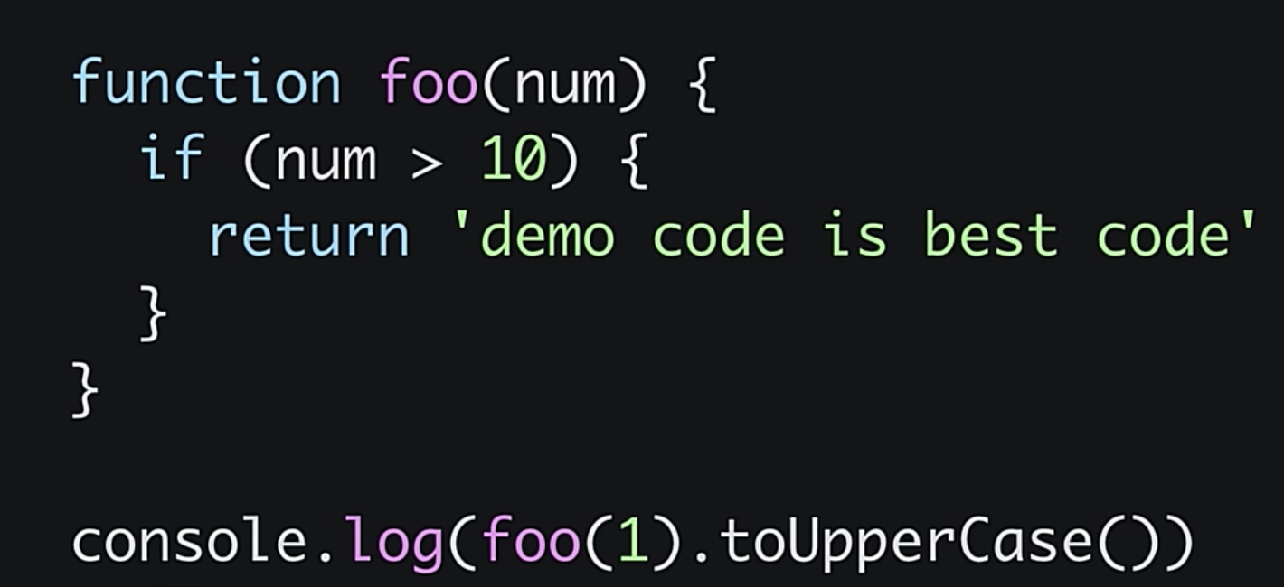
How often do we see this in Javascript?

Slide 8
Values
In Elm, and common to all functional languages, variable are immutable
Values have types which are automatically inferred by the compiler
> "hello" "hello" : String > "Hello" "Hello" : String > "Hello" ++ ", " ++ "world!" "Hello, world!" : String > n = (1 + 2) * 3 9 : number > n 9 : number

Slide 9
Functions and Lambdas
Functions are the basic building block and have a lightweight syntax
Arguments do not need to be wrapped in parens
Lambdas are anonymous functions (start with a forward slash)
isNegative n = n < 0 <function> : number -> Bool isNegative 10 False : Bool isNegative -1 True : Bool add = \x y -> x + y <function> : number -> number -> number > add 5 6 11 : number

Slide 10
Type Annotations
Optionally, the programmer can provide type annotations to function declarations which better documents what the function does
import List exposing (foldl) sum: List number -> number sum numbers = List.foldl (\n acc -> acc + n) 0 numbers > sum [1, 2, 3, 4] 10 : number

Slide 11
If Expressions
In Elm, these are expressions rather than statements and must also contain the else branch
hello = if True then "Hello" else "World" "Hello" : String world = if False then "Hello" else "World" "World" : String

Slide 12
Lists
Approximately the same a JS arrays but without the indexed access
> numbers = ["one", "two", "three"] ["one","two","three"] : List String > List.length numbers 3 : number List.reverse numbers ["three","two","one"] : List String List.map String.reverse numbers ["eno","owt","eerht"] : List String

Slide 13
Tuples
Represents logical groups of values of possibly mixed type
Useful for returning multiple values from functions
authenticate passwd = if passwd == "secret" then (True, "Authenticated") else (False, "Access denied!") > authenticate "secret" (True, "Authenticated")

Slide 14
Records
Similar to JS objects allowing logical collections of named attributes and values
> point = { x = 10, y = 20 } { x = 10, y = 20 } : { x : number, y : number1 } > point.x 10 : number > .y point 20 : number > { point | x = 15 } { x = 15, y = 20 } : { y : number1, x : number }

Slide 15
Type Inference
One of Elm's major benefits is that users do not see runtime errors in practice
Elm compiler can analyze your source code very quickly to see how values flow through your program
If a value is used in an invalid way, the compiler tells you about it with a friendly error message – this is Type Inference
The compiler figures out what type of values flow in and out of all your functions

Slide 16
Links
https://guide.elm-lang.org/install/elm.html
Introduction to elm - https://medium.com/javascript-inside/introduction-into-elm-77512c6c0baf
Watch this – excellent - https://www.youtube.com/watch?v=txxKx_I39a8

Slide 17
Summary
The current web standards, having been developed separately at different times, are inconsistent and difficult to use
Elm is attempting to create simpler more robust unified approach to web app development
The Elm language draws its design from the ML family of pure functional programming languages and cross-compiles to JS from the browser
Elm is small but includes all of the usual data structures and control and composition features
Elm is a strongly-typed language but uses a type inference system with optional type annotations allow for documentation

